Slide 1



EXPLORATORY SEGMENTATION ANALYSIS
Caregiver acceptability clusters
and held-out outcomes
Infant Autism Screening caregiver survey | REDCap export 2026-01-20 | n = 135 selected, 131 clustered
Early Social Development Lab · University of South Carolina
Lab meeting · Analysis notebook: caregiver_cluster_analysis.ipynb
Notes:
I am opening with the framing that matters most for how this deck should be read. This is an exploratory segmentation of caregiver attitudes toward infant autism screening, and everything I show comes straight out of the notebook in the project folder. I clustered on ten theory guided acceptability composites only, and I deliberately held out the four families the team asked about, which are demographics, values, autism knowledge, and the screening decision itself. That hold out is what lets me treat the screening gap you will see in a few slides as an actual finding rather than something I built into the model.

Slide 2





HEADLINE
What the analysis found
84 / 47
70.0% vs 27.7%
Profile sizes
Higher vs Conditional acceptability
Would definitely screen
56/80 vs 13/47 valid respondents
0.180
0 of 20
Average silhouette at k = 2
Modest separation, not discrete types
Held-out values and demographics
comparisons surviving FDR
Every table and figure below is reproduced verbatim from Caregiver Outputs (tables 1-11, figures 1-6).
2
Notes:
Here is the short version before I walk through the evidence. Two profiles came out of the ten acceptability domains, splitting the clustered sample 84 to 47. The held out screening question separates them hard, seventy percent versus twenty eight percent saying definitely yes, and I want to stress again that screening never touched the model. What I did not find is just as useful. The silhouette sits at 0.18, which tells me these are regions along a gradient rather than clean caregiver types, and once I applied FDR correction within the values and demographics families, nothing survived. So the actionable signal here is attitudinal and logistical, and I would not build any targeting on demographics from this.

Slide 3



DESIGN
Analytical question and locked variable roles
Question: Can caregivers be grouped by pre-outcome acceptability patterns, and how do those groups differ on the four requested held-out characterization families?
Cluster inputs
Defines the response profiles
10 directionally aligned TFA composites, each rescaled 0-100
Held-out outcome
Primary endpoint, never used to fit or name clusters
tfa_free_screen: Definitely yes (code 4) vs all other valid responses (0-3)
Held-out characterization
Examined only after assignment; FDR-adjusted within family
Demographics · Values (10 scores) · Autism knowledge (7 verified keys)
Never loaded
Privacy-conscious analytic table
Birth date, ZIP, occupation, free text, detailed race / ethnicity / income
Seed 20260725 · K-means n_init = 100 · 100 subsample stability repeats · 100 gap-statistic references
3
Notes:
I want to be explicit about role locking because it is the part of the design that carries the most weight. Only the ten acceptability composites went into the model. The screening endpoint follows the definition already recorded in the analysis tracker, which is definitely yes against every other valid answer, and missing stays missing rather than being folded into the no group. Values, knowledge, and demographics sat completely outside the fitting step, so when I compare them across profiles later I am running a genuine out of sample check. I also never loaded the direct identifiers into the analytic table, which means nothing downstream can accidentally leak them.

Slide 4

TABLE 1
Local file inventory and lineage
File | Rows | Cols | Size (KB) | SHA-256 (12) | Role in the analysis
InfantAutismScreenin-FullDataset_DATA_2026-01-20_0940.csv | 177 | 183 | 187.5 | 0aadc4ee96cf | Authoritative raw-code export
InfantAutismScreenin-FullDataset_DATA_LABELS_2026-01-20_0940.csv | 177 | 186 | 442.2 | 55ea1f9e12de | Question/response labels; sensitive fields not loaded
cleaned_autism_study_data.csv | 135 | 186 | 429.7 | 89293f2be8eb | 135-ID analytic cohort definition; selection rule undocumented
Analysis questions - Sheet3.csv | 43 | 5 | 8.7 | 0cc7ef113532 | Local analysis definitions and prior-result tracker
Open item. The raw export holds 177 records and the cleaned file names 135. The rule that selected those 135 IDs is not documented in any local file, so it is carried forward as a stated assumption rather than a verified step.
177 = 177
135 of 177
0 identifiers
Raw and labeled exports match on record count AND record order, so the two files can be validated against each other row by row.
Every selected ID is present in both exports. No selected ID is missing from the source.
Birth date, ZIP, occupation and free text are never read into the analytic table.
Source: Caregiver Outputs/table_1_file_inventory.csv · hashes are the first 12 hex characters of the full SHA-256
4
Notes:
I hashed every input before touching it so this deck can be tied back to exact files later. The two REDCap exports agree on 177 records and on record order, which is what let me validate the raw and labeled files against each other. The cleaned file is where my one real lineage gap sits. It names 135 IDs and I could not find any local documentation of how those 135 were chosen out of 177. I am treating that cohort as given because the team supplied it, but it is the first thing I would want written down before any of this gets used operationally.

Slide 5
TABLE 2
Data quality and validation checks
Check | n or difference | Interpretation
Raw REDCap records | 177 | Source population in export
Selected analytic IDs | 135 | Exact IDs in cleaned labeled subset
All three forms complete | 131 | 4 selected records are partial
Valid primary screen outcome | 131 | 4 missing remain missing
Valid calculated caregiver age | 126 | Zeros and missing excluded
Raw/labeled schema difference | 3 | Demographic labels cannot be position-zipped
Why the schema difference matters. The raw and labeled exports differ by three columns in the demographic block, so I could not zip label text onto raw codes by column position. Every demographic measure in this deck is therefore derived from the raw coded export and coded explicitly, not read off label strings.
Source: Caregiver Outputs/table_2_data_quality_summary.csv
5
Notes:
These are the checks I ran before any modeling, and two of them shaped later decisions. Four of the 135 selected records are partial, which is why my clustering cohort is 131 rather than 135. Caregiver age drops to 126 valid because I refused to treat zeros as real ages. The schema difference is small but it would have been a silent error if I had missed it. Three extra columns in the labeled demographic block mean position based zipping would have shifted labels onto the wrong variables, so I coded everything from the raw export instead.

Slide 6
TABLE 5B
Cohort flow from selected sample to primary comparison
n = 135
Selected analytic cohort
Cohort supplied in cleaned_autism_study_data.csv
n = 131
Cluster-assigned (≥8/10 input domains)
Primary clustering cohort
n = 127
Cluster-assigned with valid screening outcome
Primary held-out screening comparison
n = 4
Excluded from clustering but screening-valid
0 answered Definitely yes
Source: Caregiver Outputs/table_5b_cohort_flow.csv · 131 clustered, of whom 127 carry a valid screening response
6
Notes:
This is the attrition path in full. I required at least eight of the ten domains to be observed before a respondent could be clustered, which cost me four people and left 131. Of those, 127 also had a usable screening answer, and that 127 is the denominator behind the screening comparison. The bottom row is the one I check for bias. Those four people were excluded from clustering but did answer the screening item, and not one of them said definitely yes, so dropping them did not quietly remove enthusiastic screeners from the picture.

Slide 7
CLUSTER INPUTS
The ten TFA domains and their observed distributions
Domain (0-100, higher = more accepting) | n obs. | Missing | Mean | SD | Min | Max
Positive affect / clinical trust | 129 | 6 | 64.1 | 22.4 | 0.0 | 100.0
Low distress | 129 | 6 | 74.6 | 26.0 | 0.0 | 100.0
Low aversive affect | 130 | 5 | 96.1 | 10.1 | 50.0 | 100.0
Feasibility across pathways | 135 | 0 | 66.7 | 19.0 | 16.7 | 100.0
Low-burden modality openness | 132 | 3 | 85.1 | 15.4 | 12.5 | 100.0
Equipment-intensive openness | 133 | 2 | 41.0 | 24.5 | 0.0 | 100.0
Blood-test openness | 128 | 7 | 60.3 | 32.1 | 0.0 | 100.0
Accuracy tolerance | 135 | 0 | 37.8 | 25.3 | 0.0 | 100.0
Perceived screening utility | 135 | 0 | 76.8 | 22.0 | 0.0 | 100.0
Ethical / moral support | 135 | 0 | 78.1 | 22.0 | 0.0 | 100.0
Construction rule. Each item is rescaled to 0-100 and reverse-coded where needed, then averaged within its domain. A respondent needs ≥8 of 10 domains observed to be clustered; median imputation is applied only to sparse domain nonresponse, never to outcomes. Standardization gives every domain equal weight and assumes ordinal steps are roughly evenly spaced.
Notebook cell 5 output (Construct directionally aligned cluster inputs), X_cluster shape (131, 10)
7
Notes:
Every domain is aligned so that higher always means more accepting or more supportive, which is what makes the profile plots readable later. Two things in this table shaped my expectations before I ran anything. Low aversive affect has a mean of 96 and a standard deviation of 10, so almost nobody reports disgust or anger about screening and that domain has very little room to separate people. At the other end, blood test openness has a standard deviation of 32 and accuracy tolerance sits at a mean of 38, so those are where caregivers actually disagree. Sure enough, those are the domains that end up doing the work in the clustering.

Slide 8
CLUSTER INPUTS
Which survey items build each domain
TFA domain | REDCap variables averaged | Raw scale | Reverse-coded | Min. items
Positive affect / clinical trust | tfa_happy · tfa_trusting · tfa_comfortable | 1–5 | no | 2 of 3
Low distress | tfa_scared · tfa_sad | 1–5 | yes | 2 of 2
Low aversive affect | tfa_disgusted · tfa_angry | 1–5 | yes | 2 of 2
Feasibility across pathways | tfa_difficult + tfa_doable · tfa_separate_difficult + tfa_separate_doable · tfa_series_difficult + tfa_series_doable | 1–4 | doable only | 2 of 3
Low-burden modality openness | tfa_video · tfa_saliva · tfa_heart · tfa_observe | 1–7 | no | 3 of 4
Equipment-intensive openness | tfa_mri · tfa_eeg | 1–7 | no | 2 of 2
Blood-test openness | tfa_blood | 1–7 | no | single item
Accuracy tolerance | tfa_screen_accuracy | 1–5 | no | single item
Perceived screening utility | tfa_overall_help | 1–4 | yes | single item
Ethical / moral support | tfa_scan_any (1–5) · tfa_scan_mine (1–6) | mixed | yes | 2 of 2
24 items in, 10 domains out. Each item is rescaled to 0–100 with (x − low) / (high − low) × 100 and reverse-coded where a higher raw code meant less accepting, so every domain runs in the same direction before averaging. Accuracy tolerance is the one domain excluded when naming the profiles, since it measures tolerance for an imperfect test rather than acceptability itself.
Notebook cell 5 source (Construct directionally aligned cluster inputs) · scale bounds inferred from observed raw code ranges, not from a REDCap data dictionary
8
Notes:
This is the slide to point at when someone asks what the domains actually are. Twenty four survey items collapse into ten composites, and three design choices are worth naming out loud. First, the raw scales are not the same across items, running 1 to 5, 1 to 4, 1 to 7 and 1 to 6, so I rescaled everything to a common 0 to 100 range before averaging. Second, five domains needed reverse coding because a higher raw code meant less accepting on those items. Third, I set a minimum item count per domain so a composite is only computed when enough of its items are actually answered, which is why blood test openness has the lowest n as a single item with no partial credit. The caveat I would keep attached is that the low and high bounds come from the observed raw code ranges rather than a data dictionary, so if the slider anchors turn out different the domain means shift even though cluster membership would not.

Slide 9
TABLE 3
Cluster-count diagnostics, k = 2 through 6
k | Inertia | Silhouette | Calinski–Harabasz | Davies–Bouldin | Mean subsample ARI | P10 subsample ARI | Smallest n | Smallest %
2 | 1067.386 | 0.180 | 29.321 | 1.970 | 0.704 | 0.435 | 47 | 35.878
3 | 949.226 | 0.143 | 24.325 | 1.954 | 0.806 | 0.534 | 9 | 6.870
4 | 869.340 | 0.118 | 21.458 | 1.954 | 0.742 | 0.454 | 9 | 6.870
5 | 811.154 | 0.122 | 19.372 | 1.877 | 0.576 | 0.412 | 9 | 6.870
6 | 765.447 | 0.127 | 17.785 | 1.786 | 0.555 | 0.398 | 5 | 3.817
Preferred k by criterion
Reading this honestly
Criterion | Preferred k
Highest silhouette | 2
Highest Calinski–Harabasz | 2
Lowest Davies–Bouldin | 6
Highest mean subsample stability | 3
Gap statistic 1-SE choice | 2
Criteria disagree. Silhouette, Calinski–Harabasz and the gap statistic point to k = 2; Davies–Bouldin prefers 6 and stability prefers 3.
k ≥ 3 fragments. Every solution from 3 upward produces a cluster of 9 or fewer people (≤6.9% of the sample), too small to characterize on held-out measures.
Separation is weak everywhere. No k reaches the 0.25 silhouette reference line. This is a gradient, not a set of natural kinds.
Source: Caregiver Outputs/table_3_cluster_diagnostics.csv, values shown at notebook display precision
9
Notes:
I do not want to oversell k equals two, so here is the full grid. Three of the five criteria favor two clusters and two of them do not, and that disagreement is itself informative. The practical tiebreaker for me was the smallest cluster column. From k equals three onward there is always a group of nine or fewer people, and I cannot responsibly characterize a group that size on held out demographics or knowledge scores. The other thing to sit with is that no value of k clears the 0.25 silhouette reference. Whatever structure is here, it is a soft gradient and I would resist language that turns these into caregiver personality types.

Slide 10
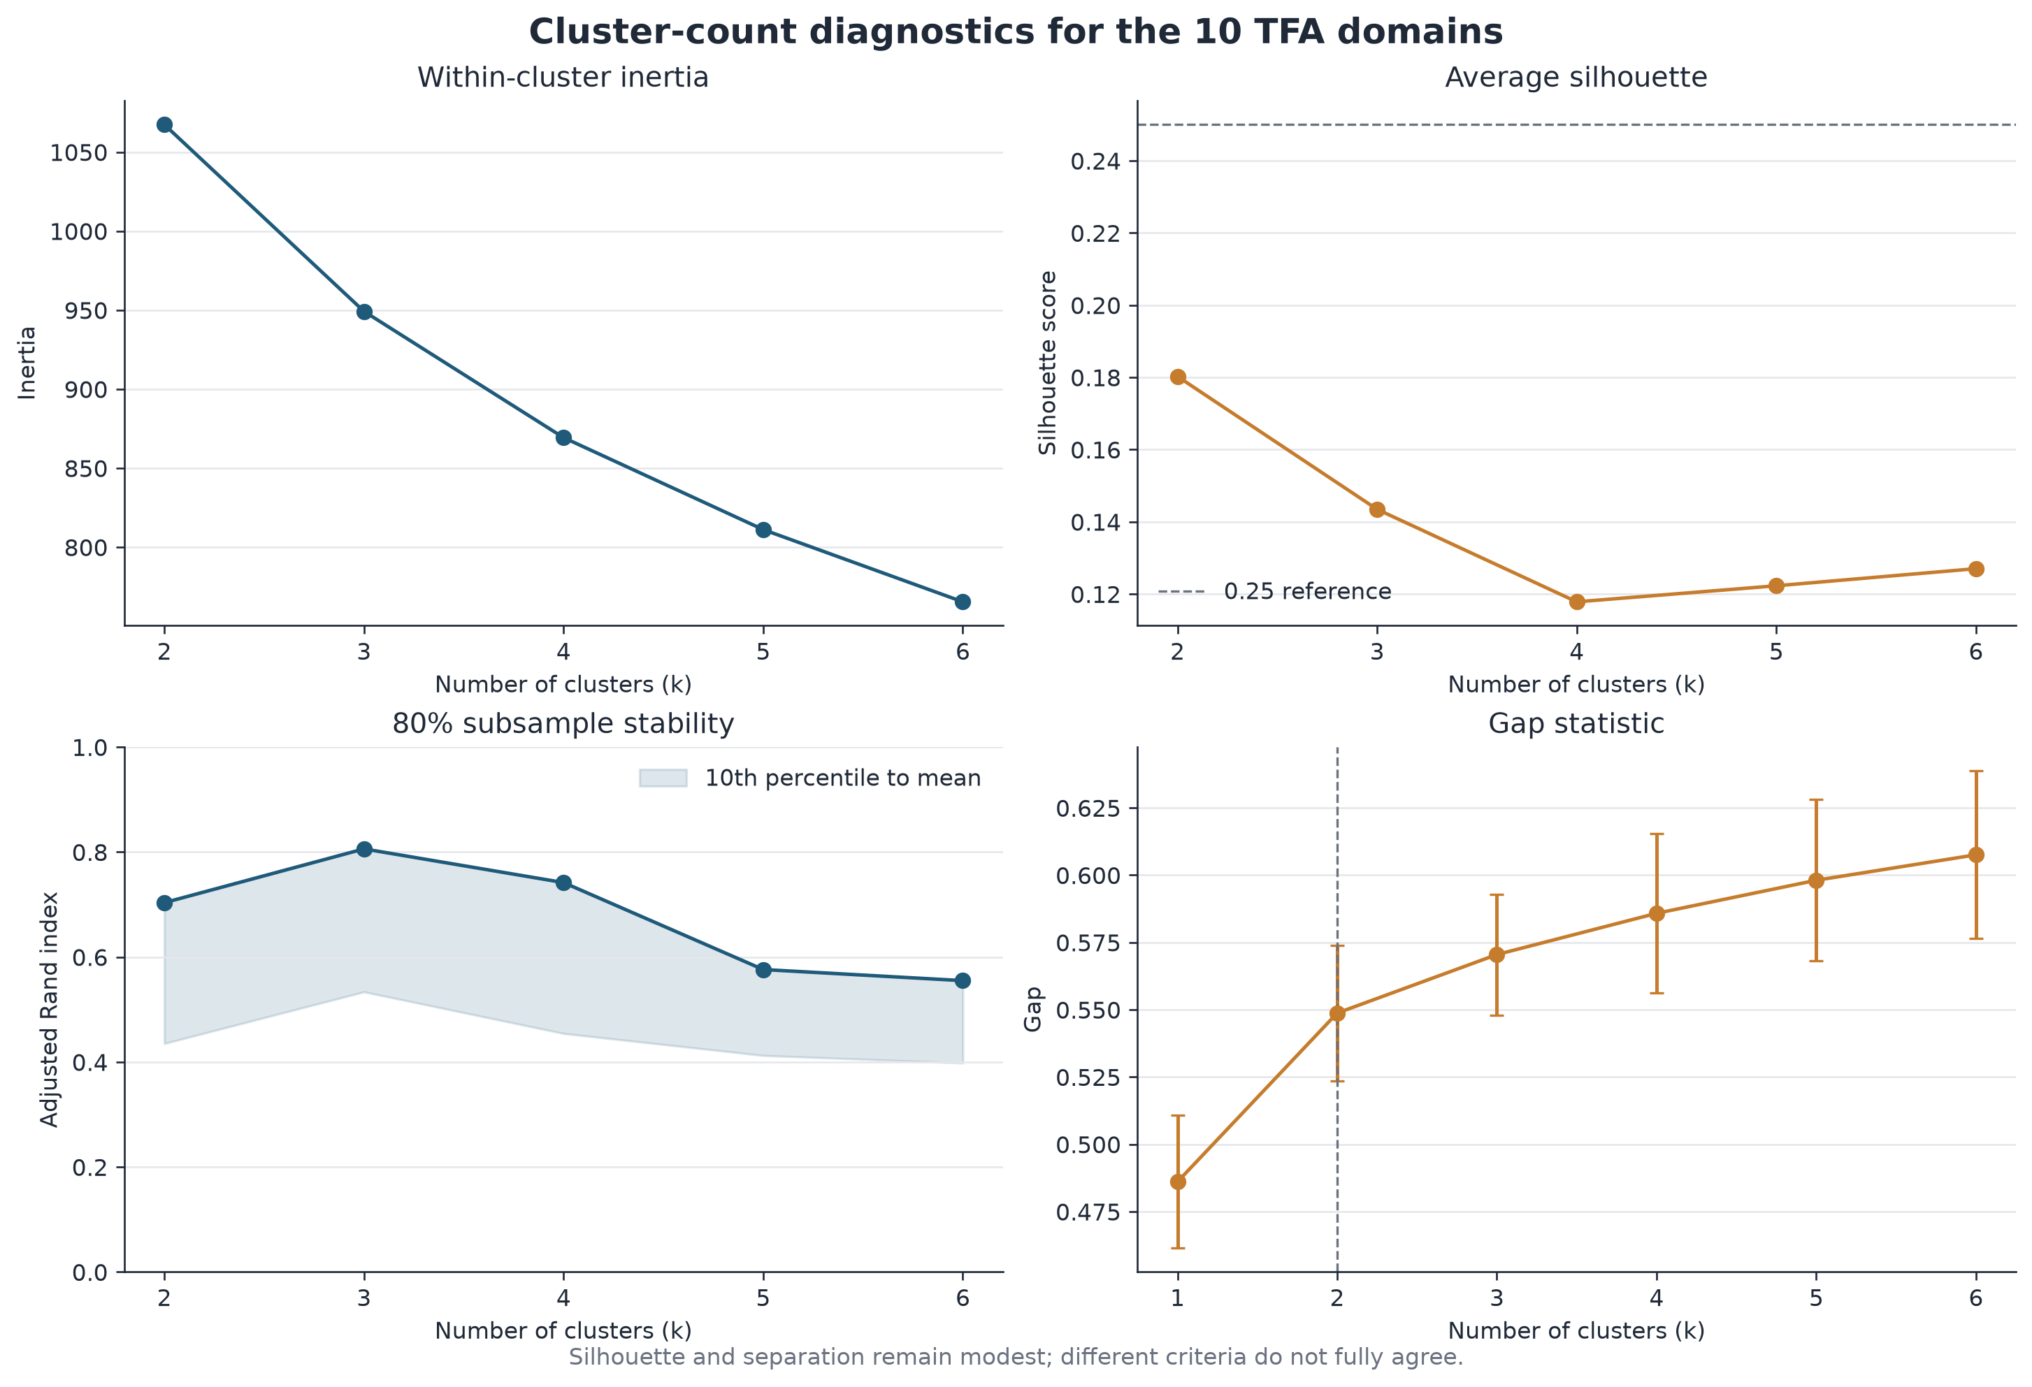
FIGURE 1
Cluster-count diagnostics for the 10 TFA domains
Inertia falls smoothly with no elbow · silhouette peaks at k = 2 but never reaches 0.25 · subsample ARI peaks at k = 3 · the gap statistic 1-SE rule selects k = 2
Source: Caregiver Outputs/figure_1_cluster_count_diagnostics.png (240 dpi export)
10
Notes:
The inertia curve in the top left is the clearest signal in this figure, and what it tells me is that there is no elbow. It just decays. If there were genuinely separate caregiver populations I would expect a kink, and there is none. The silhouette panel sits entirely below the dashed reference line. The stability panel is worth a second look because the shaded band runs from the tenth percentile up to the mean, and even at its best around k equals three the tenth percentile is only about 0.53, meaning one run in ten reshuffles a lot of people. The gap statistic keeps rising with k, so its one standard error rule picks the smallest defensible value, which is two.

Slide 11
DECISION
Why the deck reports k = 2
1
Strongest separation metrics
k = 2 has the highest silhouette (0.180) and the highest Calinski–Harabasz (29.321) of any candidate, and it is the gap statistic's 1-SE choice.
2
Both groups are large enough to characterize
47 and 84 people. Every k ≥ 3 solution produces a cluster of 9 or fewer (≤6.9%), too small for held-out comparison.
3
Parsimony under acknowledged uncertainty
Since no k is well separated, the fewest groups that still carry a decision-relevant difference is the defensible choice.
!
What this is not
Not proof of naturally discrete caregiver populations. Membership shifts under alternative preprocessing and under Ward clustering (see Table 10).
SELECTED_K = 2 in the notebook; k = 3–6 models were fitted and diagnosed but are not reported downstream
11
Notes:
I want to defend this choice out loud rather than let it pass silently. Two clusters wins on the separation metrics and it is the parsimonious choice given that nothing is well separated anywhere. The decisive practical argument is cluster size, because a nine person cluster cannot support any of the held out comparisons that follow. The bottom row is my caveat and I would not drop it from any version of this deck. Under Ward linkage the split moves to 88 and 43, and under complete case filtering the agreement with my primary solution falls to 0.58, so the boundary between these two groups is real but soft.

Slide 12
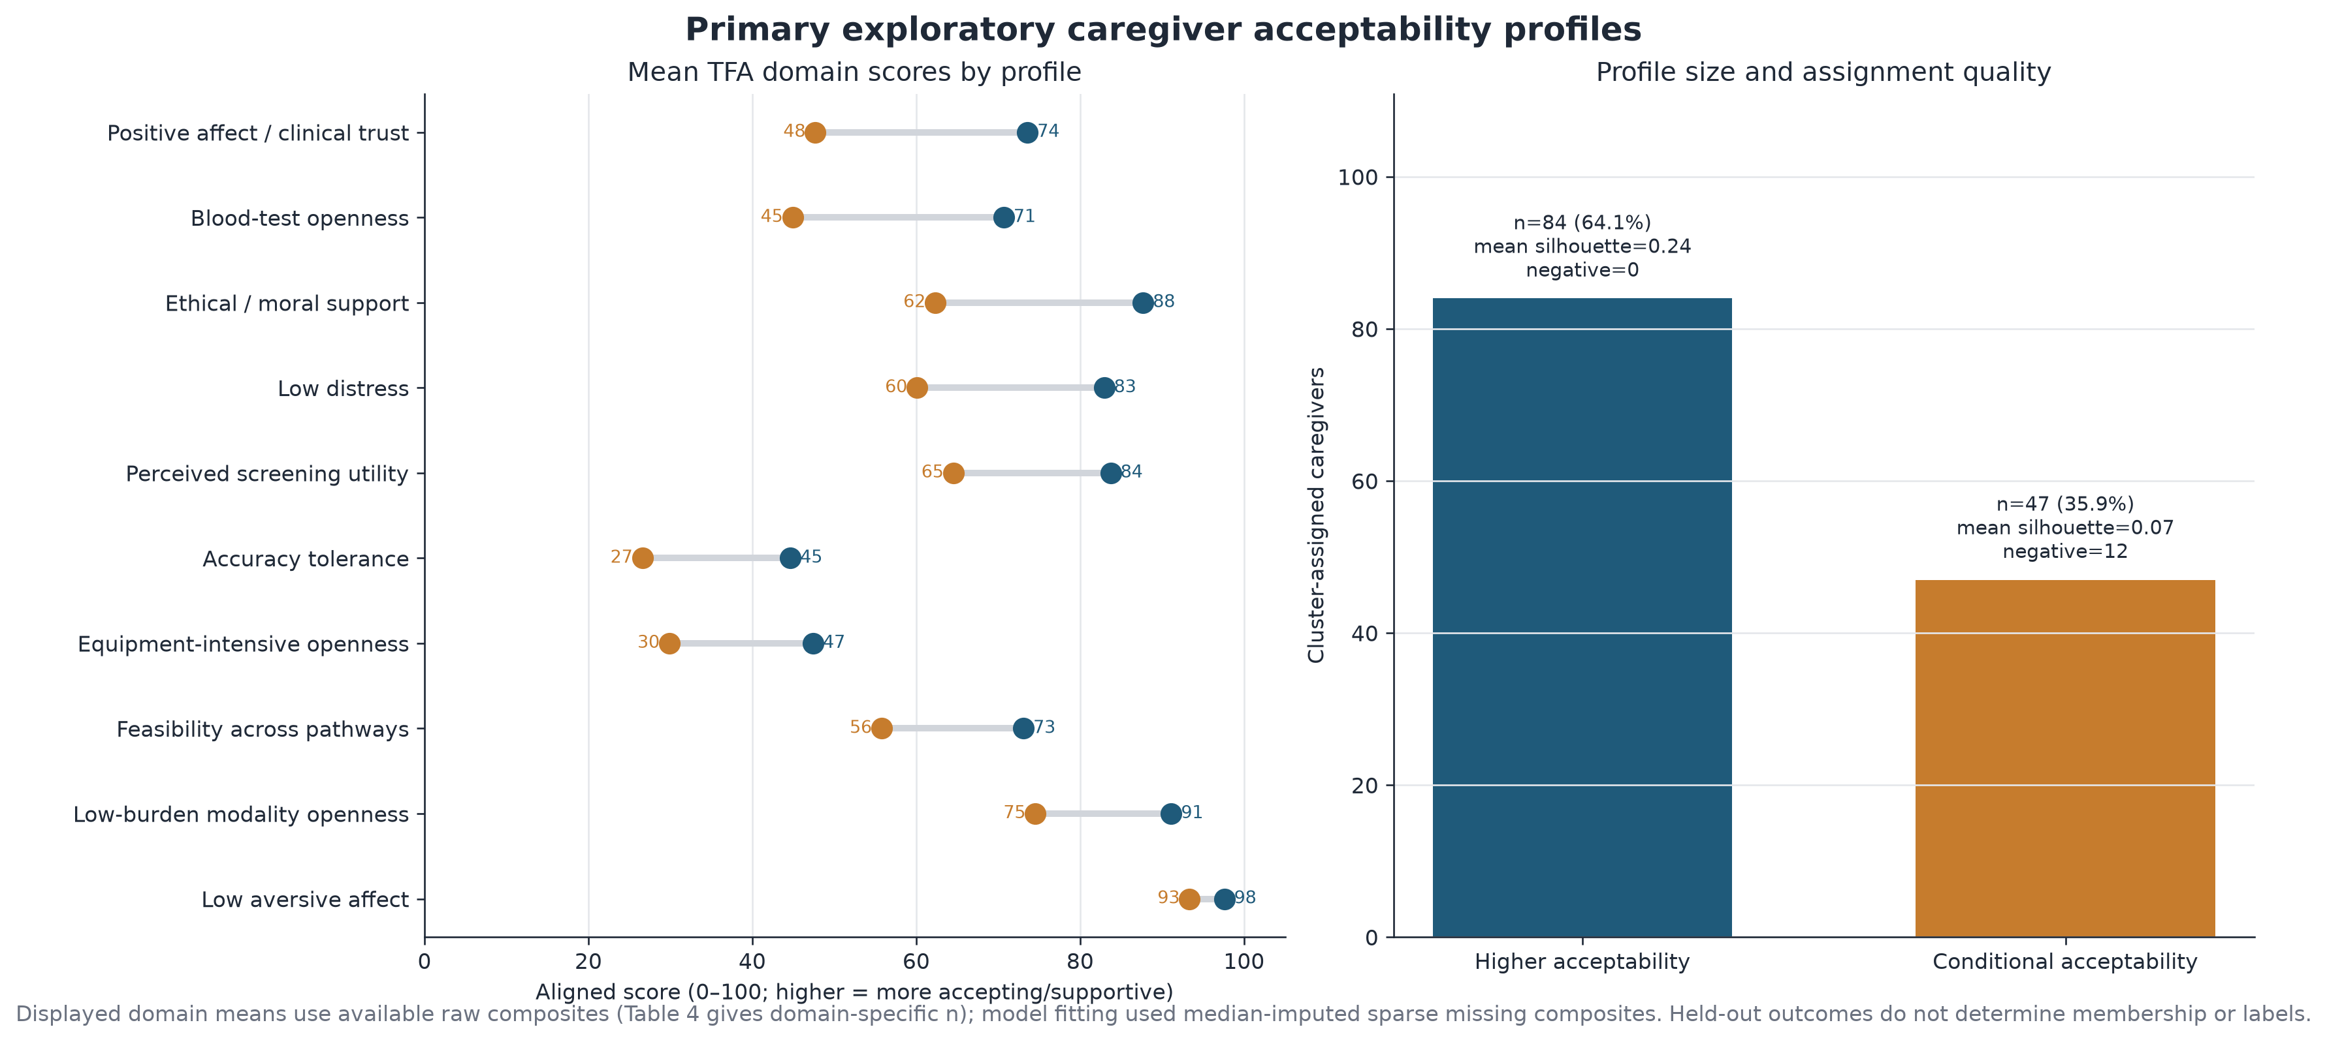
FIGURE 2
Primary exploratory caregiver acceptability profiles
Source: Caregiver Outputs/figure_2_primary_cluster_profiles.png · Higher acceptability mean silhouette 0.24 (0 negative) · Conditional 0.07 (12 negative, 25.5%)
12
Notes:
The left panel is the whole segmentation in one view. Every domain is higher in the blue profile, and that is exactly what a gradient looks like rather than two groups with different shapes. Notice the bottom row, low aversive affect, where the two profiles sit at 98 and 93 and effectively touch. That domain contributes almost nothing. The right panel carries a caution I do not want buried. The Higher acceptability profile has a mean silhouette of 0.24 with no negatively assigned cases, but the Conditional profile sits at 0.07 with twelve people, a quarter of that group, showing negative silhouettes. Those twelve are closer to the other cluster than to their own, so the Conditional label is doing looser work than the Higher one.

Slide 13
TABLE 4
Cluster-defining domain profiles, ranked by gap
TFA domain | Higher acceptability | Conditional acceptability | n (higher) | n (cond.) | Difference (points)
Positive affect / clinical trust | 73.6 | 47.7 | 82 | 47 | 25.9
Blood-test openness | 70.7 | 44.9 | 79 | 46 | 25.7
Ethical / moral support | 87.7 | 62.3 | 84 | 47 | 25.3
Low distress | 82.9 | 60.1 | 82 | 47 | 22.8
Perceived screening utility | 83.7 | 64.5 | 84 | 47 | 19.2
Accuracy tolerance | 44.6 | 26.6 | 84 | 47 | 18.0
Equipment-intensive openness | 47.4 | 29.9 | 84 | 46 | 17.5
Feasibility across pathways | 73.1 | 55.8 | 84 | 47 | 17.3
Low-burden modality openness | 91.1 | 74.5 | 83 | 46 | 16.6
Low aversive affect | 97.6 | 93.4 | 83 | 47 | 4.2
THE THREE WIDEST GAPS
25.9 pts
25.7 pts
25.3 pts
Positive affect / clinical trust
Blood-test openness
Ethical / moral support
Both profiles stay comparatively open to low-burden modalities (91.1 vs 74.5) and neither reports much aversion (97.6 vs 93.4). The separation is concentrated in trust, invasiveness tolerance, ethical comfort and perceived accuracy, all of which are addressable through pathway design and communication.
Source: Caregiver Outputs/table_4_cluster_defining_profiles.csv · displayed means use available raw composites, so n varies by domain
13
Notes:
Ranking by the gap tells me what the model actually keyed on. The top three are positive affect and clinical trust, blood test openness, and ethical or moral support, each about 25 points apart. That combination reads to me as trust plus tolerance for invasiveness rather than any general enthusiasm about autism screening. The bottom row is the useful null. Low aversive affect differs by only 4.2 points, so no one in either profile is repelled by the idea. And the low burden modality row at 91 versus 75 is the most encouraging number on this slide, because it says the Conditional group is not refusing screening, it is refusing certain versions of it.

Slide 14
PART TWO
Held-out characterization
Screen vs not · autism knowledge · values · demographics and family context
None of these measures influenced cluster fitting or cluster naming. Each uses its own valid denominator.
Notes:
Everything from this point on is an out of sample check. I fitted and named the clusters before looking at any of these four families, which is what gives the next few slides their credibility. I also let each measure use its own valid denominator instead of forcing a common complete case sample, because forcing one would have thrown away real information for no methodological gain. Where a family contains several tests I corrected within that family using Benjamini Hochberg, and I will flag every place that correction changes the story.

Slide 15
TABLE 5
Held-out primary outcome: would you screen?
Profile | Cluster n | Valid | Missing | No / probably not / unsure | Probably | Definitely yes | Wilson 95% CI (definitely yes) | Probably or definitely yes
Higher acceptability | 84 | 80 | 4 | 8 (10.0%) | 16 (20.0%) | 56 (70.0%) | 59.2% to 78.9% | 72 (90.0%)
Conditional acceptability | 47 | 47 | 0 | 19 (40.4%) | 15 (31.9%) | 13 (27.7%) | 16.9% to 41.8% | 28 (59.6%)
42.3
30.4
0
percentage points
percentage points
of 4
Absolute gap in definitely-yes rate
Gap on the wider probably-or-definitely measure
Excluded partial records answering definitely yes
The Wilson intervals do not overlap. 59.2–78.9% against 16.9–41.8%. This is the single largest held-out difference in the analysis, and it comes from a measure the clustering never saw.
Source: Caregiver Outputs/table_5_screening_outcome.csv · endpoint per Analysis questions - Sheet3.csv: code 4 vs codes 0–3, missing stays missing
15
Notes:
This is the payoff slide. Seventy percent of the Higher acceptability profile say they would definitely screen against twenty eight percent of the Conditional profile, and the Wilson intervals are nowhere near each other. Because screening was held out entirely, I read this as evidence that the acceptability composites carry real information about stated intent. The second stat card matters for how we talk about the Conditional group. On the looser probably or definitely measure they reach sixty percent, so the honest framing is that they are hesitant rather than opposed. I also checked the four excluded partial records and none of them said definitely yes, so my exclusion rule did not manufacture this gap.

Slide 16
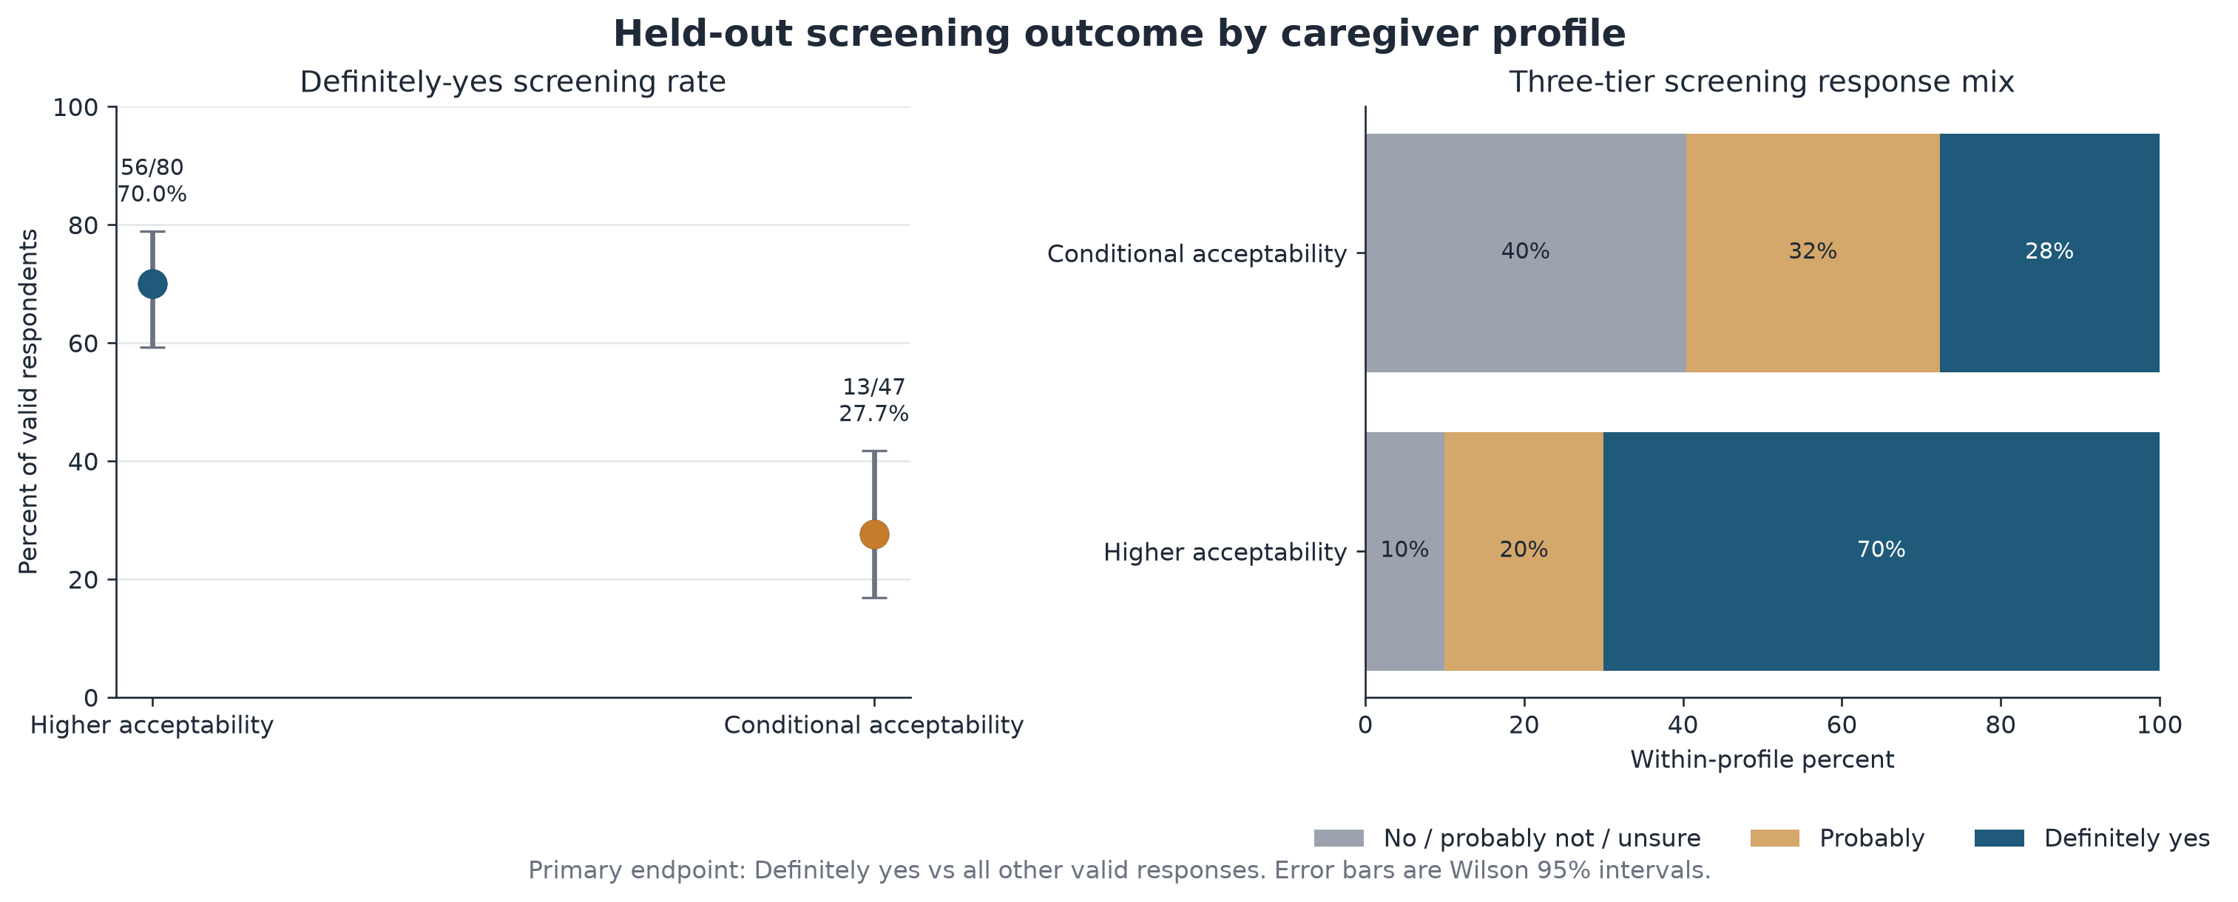
FIGURE 3
Held-out screening outcome by caregiver profile
Source: Caregiver Outputs/figure_3_screening_outcome.png · error bars are Wilson 95% intervals
16
Notes:
The right hand panel is the one I would put in front of a clinical audience because it shows the whole response distribution rather than a single collapsed rate. In the Conditional profile, forty percent land in the no, probably not, or unsure band and another thirty two percent say probably. That middle band is where the design opportunity sits. These are not refusers, they are people waiting to hear how the screening would actually work. In the Higher acceptability profile only ten percent fall into that first band, so there is very little left to persuade there.

Slide 17
TABLE 6
Held-out autism knowledge: verified score and sensitivity scores
Measure | Profile | n | Mean | SD | Median | Q1 | Q3 | Mean % of range | Mann–Whitney p
Verified objective knowledge | Higher | 77 | 3.90 | 1.57 | 4.0 | 3.0 | 5.0 | 55.7% | 0.099
(7 verified keys, range 0–7) | Conditional | 46 | 3.41 | 1.72 | 4.0 | 2.0 | 4.0 | 48.8% | 0.099
8-item sensitivity: Before 1 year correct | Higher | 77 | 4.17 | 1.63 | 5.0 | 3.0 | 5.0 | 52.1% | 0.064
 | Conditional | 46 | 3.61 | 1.73 | 4.0 | 2.25 | 5.0 | 45.1% | 0.064
8-item sensitivity: 1–2 years correct | Higher | 77 | 4.32 | 1.64 | 5.0 | 3.0 | 5.0 | 54.1% | 0.228
 | Conditional | 46 | 3.96 | 1.80 | 4.0 | 3.0 | 5.0 | 49.5% | 0.228
Self-rated knowledge | Higher | 84 | 3.49 | 0.88 | 3.0 | 3.0 | 4.0 | 62.2% | 0.752
(subjective, 1–5) | Conditional | 47 | 3.51 | 0.75 | 4.0 | 3.0 | 4.0 | 62.8% | 0.752
The behavior-age item is unresolved. Seven of the eight knowledge keys are verified and form the primary score. The correct answer for tfa_behavior_age is not documented locally, so it appears only in the two 8-item sensitivity rows, scored both ways. Neither version changes the conclusion.
Source: Caregiver Outputs/table_6_knowledge_summary.csv
17
Notes:
Knowledge was the family I most expected to separate the profiles, and it does not. The Higher acceptability group scores 3.90 out of seven against 3.41, and the Mann Whitney p is 0.099, which does not clear the line even before I think about multiplicity. I ran the eight item version both ways to handle the unresolved behavior age key and got 0.064 and 0.228, so the answer does not hinge on that unresolved item. The self rated row is the one I find most interesting. Both profiles rate their own knowledge at essentially the same level, around 3.5 out of five, while their objective scores differ slightly. Perceived expertise is not tracking actual expertise here, and it is certainly not what is driving screening intent.

Slide 18
TABLE 6B
Item-level correct-response rates on the seven verified keys
Item | Variable | Higher acceptability | Conditional acceptability | Higher: correct / valid | Conditional: correct / valid
Tylenol | tfa_tylenol | 78.0% [67.9, 85.6] | 74.5% [60.5, 84.7] | 64 / 82 | 35 / 47
Vaccines | tfa_vaccines | 74.4% [64.0, 82.6] | 72.3% [58.2, 83.1] | 61 / 82 | 34 / 47
Why diagnoses increased | tfa_rate | 67.9% [57.1, 77.1] | 55.3% [41.2, 68.6] | 55 / 81 | 26 / 47
Medication | tfa_medications | 49.4% [38.8, 60.0] | 53.2% [39.2, 66.7] | 40 / 81 | 25 / 47
US prevalence | tfa_autistic_us | 50.0% [39.3, 60.7] | 30.4% [19.1, 44.8] | 40 / 80 | 14 / 46
Sibling recurrence | tfa_mult_kids_odds | 44.4% [34.1, 55.3] | 38.3% [25.8, 52.6] | 36 / 81 | 18 / 47
Genetics | tfa_genetics | 30.0% [21.1, 40.8] | 21.3% [12.0, 34.9] | 24 / 80 | 10 / 47
Every confidence interval overlaps between profiles. The item ordering is nearly identical in both groups: caregivers are well informed about the vaccine and Tylenol myths and poorly informed about genetics, sibling recurrence and prevalence. Only 30.0% and 21.3% answer the genetics item correctly.
Brackets are 95% confidence intervals on the correct-response percentage; denominators are item-specific available cases.
Source: Caregiver Outputs/table_6b_knowledge_item_results.csv
18
Notes:
Breaking the score into items is where I found the most directly useful content in this whole analysis. The two profiles answer in nearly the same rank order, which reinforces that knowledge is not what divides them. What jumps out instead is the shared gap. Vaccines and Tylenol are at roughly seventy five percent correct in both groups, which is genuinely good news about public messaging on those myths. Genetics is at thirty percent and twenty one percent, sibling recurrence sits in the low forties, and prevalence is at fifty and thirty. So caregivers have absorbed what autism is not caused by and have not absorbed the heritability picture, which is precisely the content that would make an early screening offer make sense to them.

Slide 19
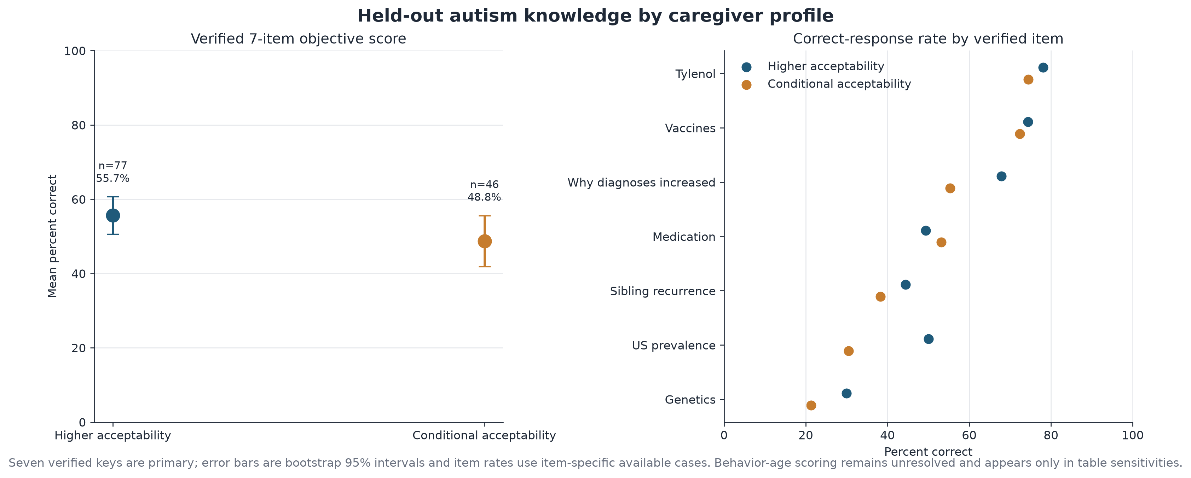
FIGURE 4
Held-out autism knowledge by caregiver profile
Source: Caregiver Outputs/figure_4_autism_knowledge.png · error bars are bootstrap 95% intervals; item rates use item-specific available cases
19
Notes:
The left panel shows the bootstrap intervals overlapping across most of their range, which is the visual version of that p equals 0.099. The right panel is the one I keep coming back to. Read down the vertical ordering and the two colors track each other closely at the top and stay close at the bottom. The only items with visible daylight between them are prevalence and why diagnoses increased, and even those have overlapping intervals in the table. If knowledge were driving acceptability I would expect the blue dots to sit consistently to the right, and they do not.

Slide 20
TABLE 7
Held-out Schwartz values, all ten scores
Value | Higher: n | Higher: mean (SD) | Cond.: n | Cond.: mean (SD) | Cohen's d | Raw p | BH-adjusted p
Self-direction | 84 | 5.32 (0.84) | 47 | 4.87 (1.08) | 0.483 | 0.013 | 0.129
Stimulation | 84 | 3.61 (1.26) | 47 | 3.17 (1.19) | 0.354 | 0.059 | 0.293
Hedonism | 84 | 4.26 (1.17) | 47 | 3.91 (1.33) | 0.282 | 0.131 | 0.437
Universalism | 84 | 5.40 (0.78) | 47 | 5.15 (1.25) | 0.263 | 0.625 | 0.932
Power | 84 | 3.31 (1.42) | 47 | 3.04 (1.40) | 0.189 | 0.324 | 0.810
Benevolence | 84 | 5.54 (0.63) | 47 | 5.40 (0.95) | 0.173 | 0.925 | 0.932
Security | 84 | 4.61 (1.13) | 47 | 4.47 (1.30) | 0.117 | 0.697 | 0.932
Conformity | 84 | 4.80 (1.17) | 47 | 4.85 (1.14) | -0.046 | 0.818 | 0.932
Tradition | 84 | 3.64 (1.91) | 47 | 3.68 (1.77) | -0.020 | 0.930 | 0.932
Achievement | 84 | 3.87 (1.44) | 47 | 3.89 (1.46) | -0.017 | 0.932 | 0.932
No values comparison survives FDR correction. Self-direction is nominally significant at p = 0.013 with d = 0.483, but the minimum Benjamini–Hochberg adjusted p across all ten tests is 0.129. Scoring and centering formulas are not documented in the local files.
Source: Caregiver Outputs/table_7_values_summary.csv · observed scale 1–6, higher interpreted as stronger endorsement
20
Notes:
Ten separate value scores means ten separate chances to find something by accident, so I corrected within the family rather than reporting them one at a time. Self direction is the only one that would look significant on its own, at p equals 0.013 with a small to moderate effect size around 0.48, and it is a plausible story that caregivers who prize autonomy are more open to a screening offer. But once I adjust, the smallest p in the family is 0.129 and nothing clears. I am reporting it because it is a reasonable hypothesis for a future study, not because this sample supports it. I should also flag that the local files never document how these value scores were computed or centered, so the absolute levels should be treated cautiously.

Slide 21
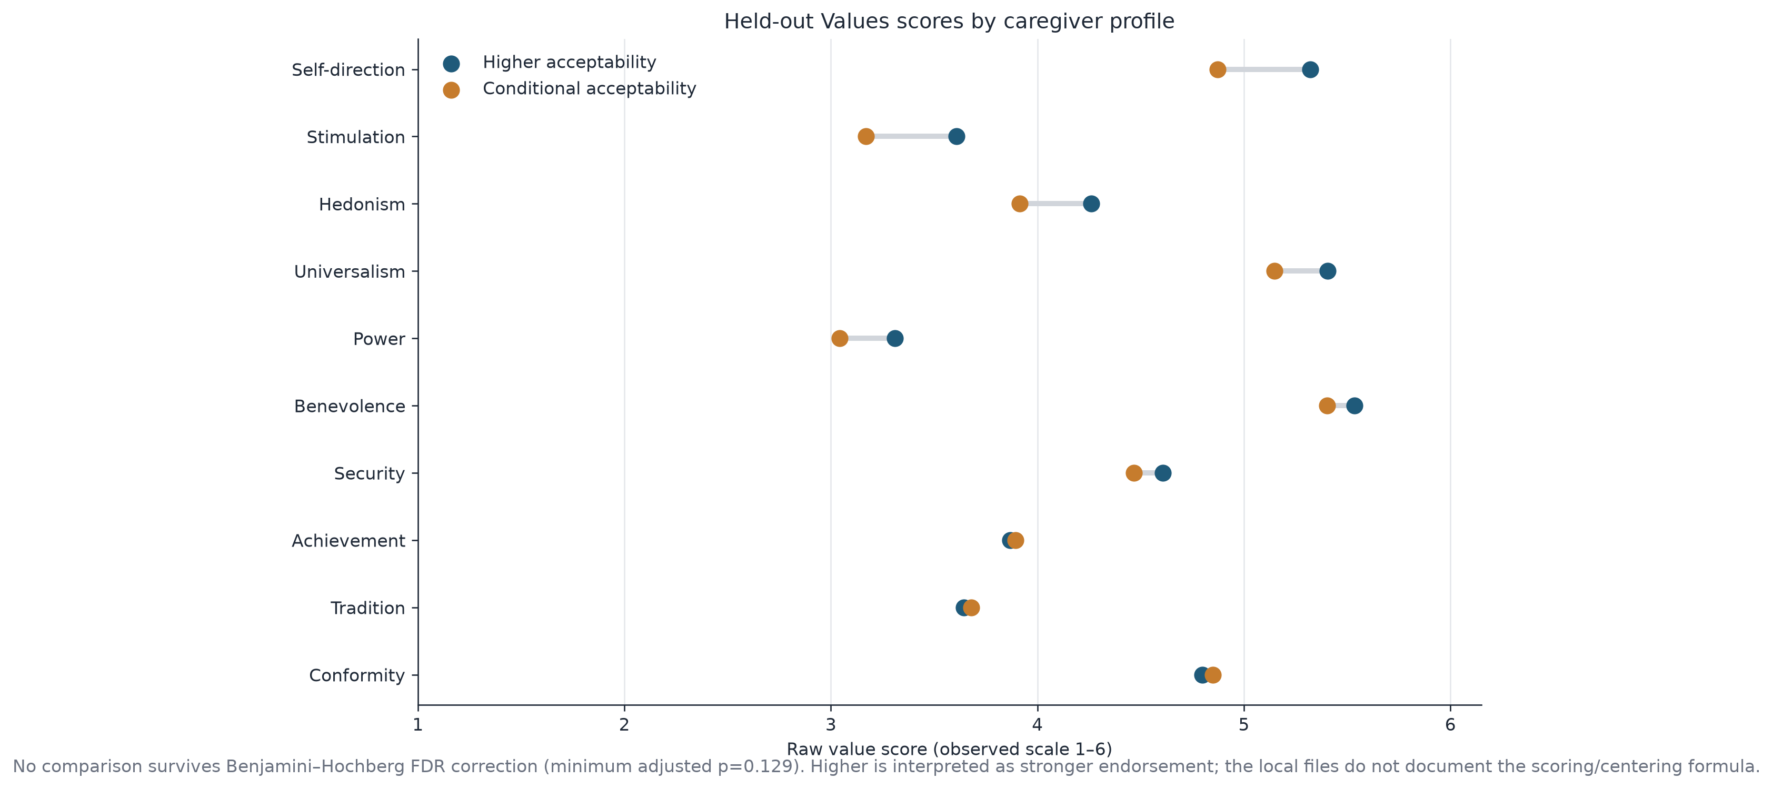
FIGURE 5
Held-out Values scores by caregiver profile
Source: Caregiver Outputs/figure_5_values_characterization.png · minimum BH-adjusted p across the family = 0.129
21
Notes:
Visually this is a slide about how small these gaps are. Self direction at the top has the widest separation on the plot and it is still under half a scale point on a one to six range. From benevolence downward the two dots essentially sit on top of each other, and for achievement, tradition, and conformity the ordering actually flips, with the Conditional profile scoring marginally higher. That flip is the clearest sign that I am looking at noise. Both profiles share the same value hierarchy, putting benevolence, universalism, and self direction at the top and power and tradition at the bottom.

Slide 22
TABLE 8
Held-out demographics and family context
Measure | Type | Effect | Higher acceptability | Conditional acceptability | Effect size | Raw p | BH-adj. p
Caregiver age at 2025-09-29 | continuous | Cohen's d | 38.0 [33.0, 42.0] (n=79) | 36.0 [33.0, 40.0] (n=43) | 0.190 | 0.247 | 0.781
Household size | continuous | Cohen's d | 4.0 [3.0, 5.0] (n=79) | 4.0 [3.2, 4.8] (n=46) | 0.086 | 0.560 | 0.781
Number of children | continuous | Cohen's d | 2.0 [2.0, 3.0] (n=84) | 2.0 [2.0, 3.0] (n=47) | -0.025 | 0.946 | 0.946
Bachelor's degree or higher | binary | Cohen's h | 54/80 (68%) | 34/47 (72%) | -0.106 | 0.568 | 0.781
Currently employed | binary | Cohen's h | 53/80 (66%) | 30/47 (64%) | 0.051 | 0.782 | 0.860
Rural area | binary | Cohen's h | 18/80 (22%) | 8/47 (17%) | 0.138 | 0.504 | 0.781
Very easy healthcare access | binary | Cohen's h | 60/80 (75%) | 32/46 (70%) | 0.122 | 0.508 | 0.781
Household with ≥1 autistic child | binary | Cohen's h | 35/84 (42%) | 24/47 (51%) | -0.189 | 0.300 | 0.781
Works with autistic people | binary | Cohen's h | 28/84 (33%) | 17/47 (36%) | -0.060 | 0.743 | 0.860
Any child with special needs/disabilities | binary | Cohen's h | 39/84 (46%) | 25/47 (53%) | -0.135 | 0.458 | 0.781
Any premature birth | binary | Cohen's h | 25/84 (30%) | 22/47 (47%) | -0.353 | 0.051 | 0.562
Nothing survives correction. Premature birth history is the largest signal (47% vs 30%, raw p = 0.051) and still adjusts to 0.562. Continuous measures show median [Q1, Q3]. Binary measures with event or complement counts below 5 are suppressed for disclosure control.
Source: Caregiver Outputs/table_8_demographics_summary.csv · detailed race, ethnicity, gender, income, DOB, ZIP, occupation and free text are omitted by design
22
Notes:
This is the slide that should stop anyone from building demographic targeting on top of this work. Eleven measures, not one of them adjusting below 0.5. Education, employment, rurality, and healthcare access are flat across the profiles. The two rows worth a second look both run against the intuitive direction. The Conditional profile is slightly more likely to have an autistic child at home, fifty one against forty two percent, and noticeably more likely to report a premature birth, forty seven against thirty percent with a raw p right at 0.051. If that premature birth pattern holds in a larger sample it would be worth chasing, since those families have more medical system contact and may be reacting to burden rather than to autism screening itself. In this sample it is a hypothesis, nothing more.

Slide 23
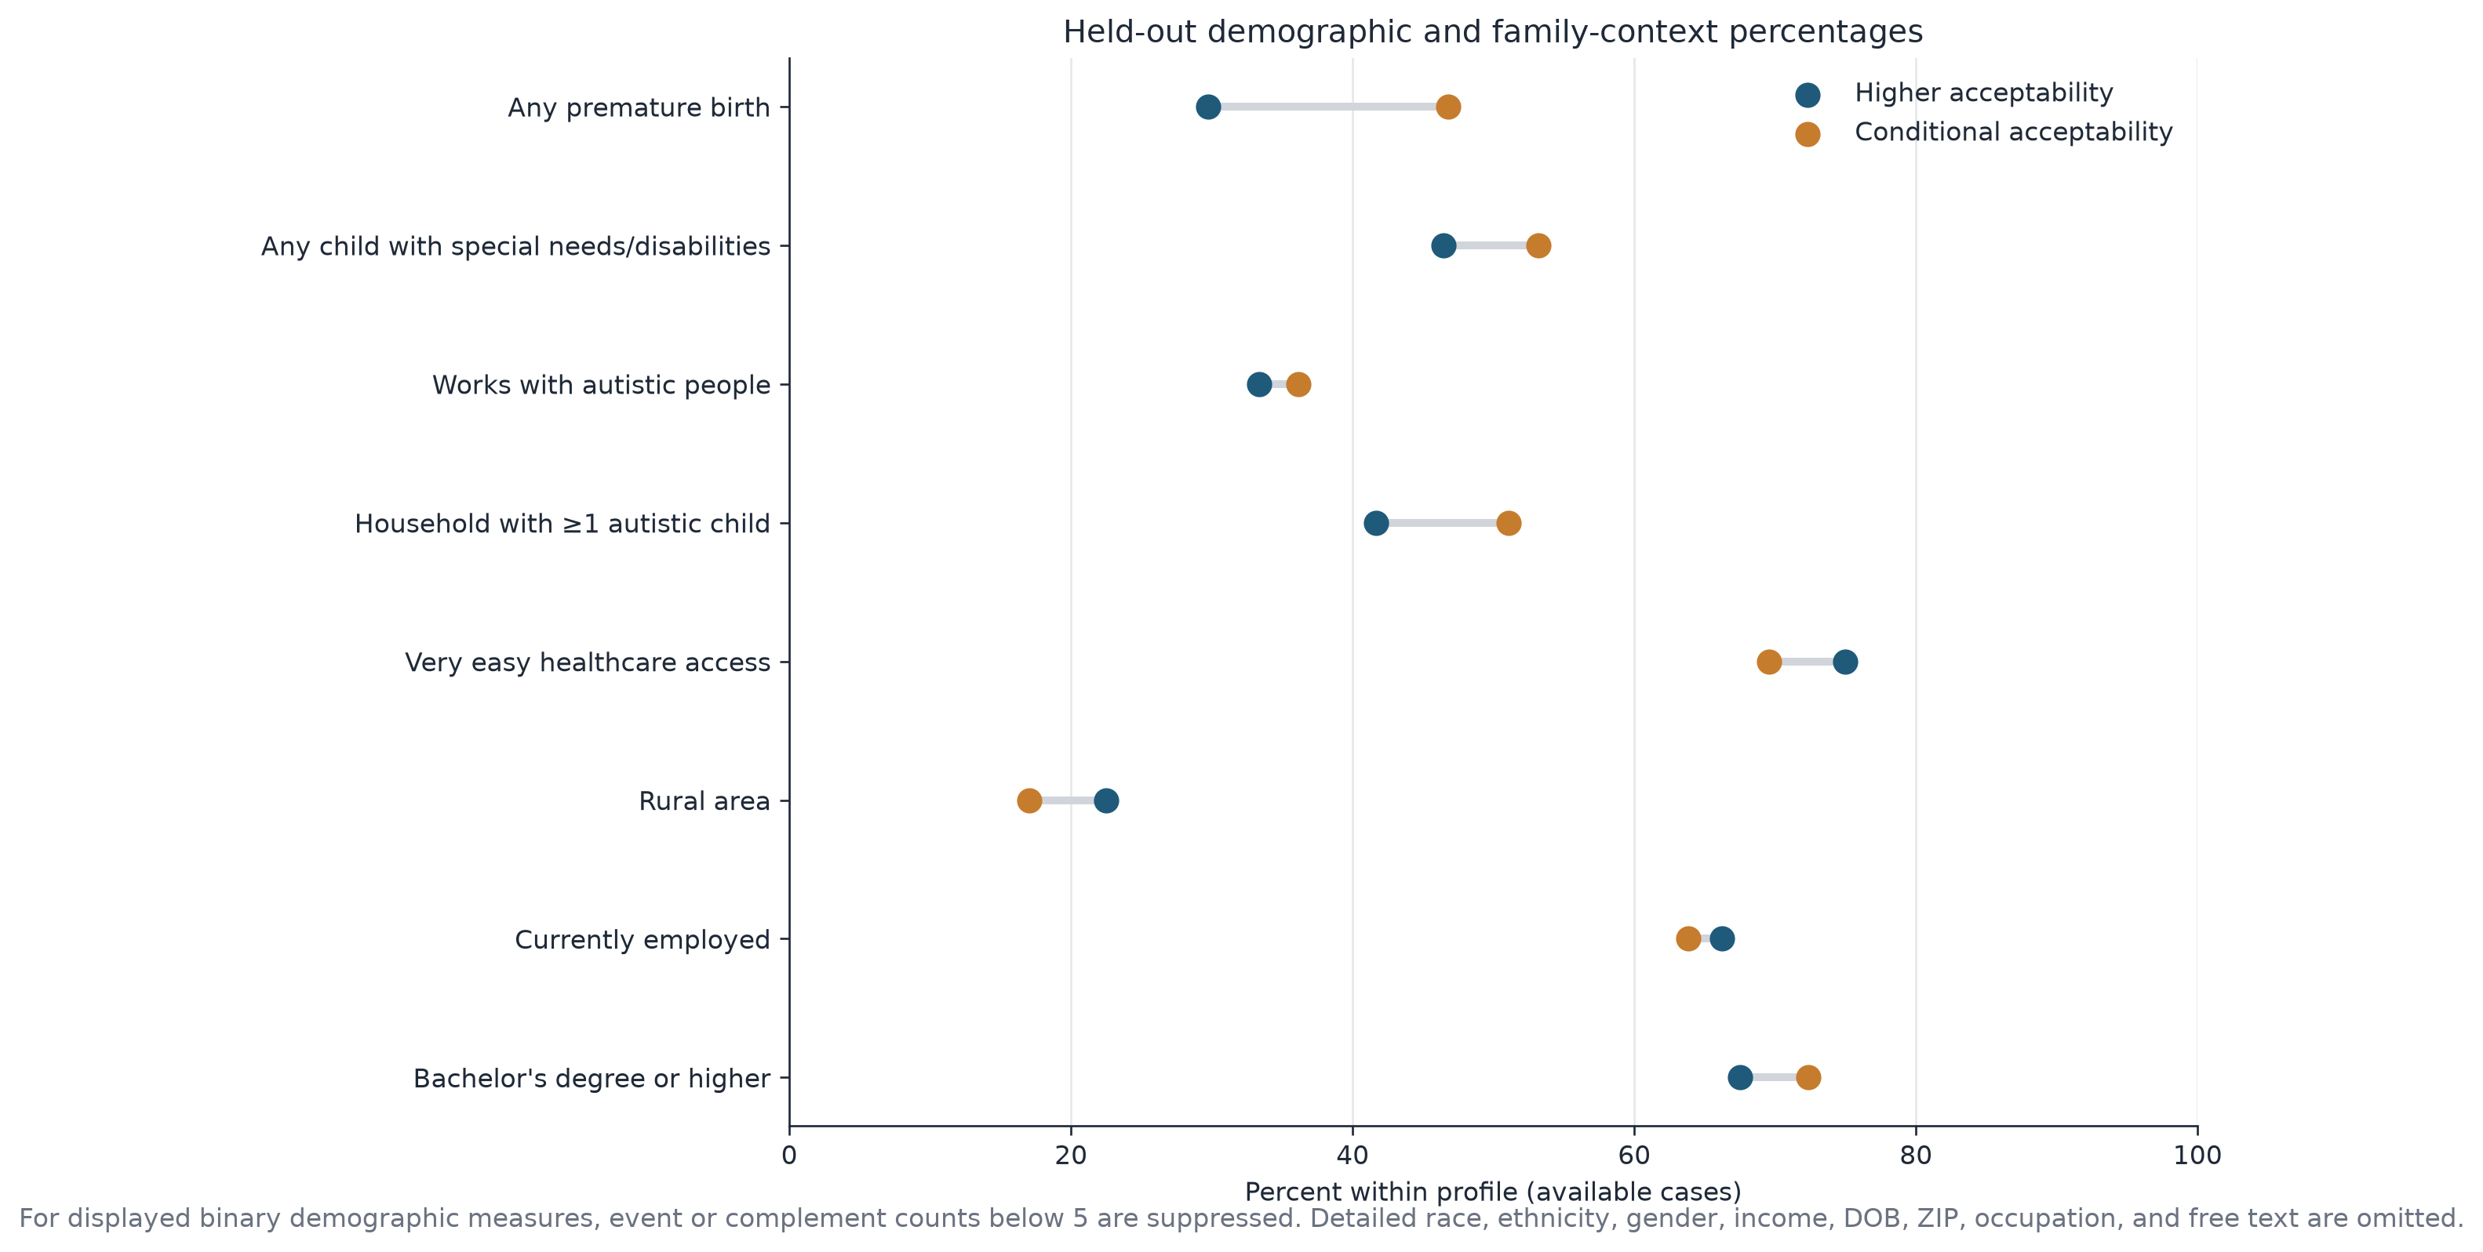
FIGURE 6
Held-out demographic and family-context percentages
Source: Caregiver Outputs/figure_6_demographic_characterization.png · counts below 5 suppressed
23
Notes:
Reading this plot from the bottom up, the first five rows are nearly stacked, which is exactly the flat picture the table describes. The top two rows are where the dots pull apart, and in both cases the orange dot sits to the right, meaning the Conditional profile reports more premature births and more children with special needs. That is the opposite of what a simple exposure story would predict, where families with more disability experience would be more comfortable with screening. It fits better with a burden story, that these families already carry a heavy appointment load and are reacting to what screening would cost them in time and visits.

Slide 24
TABLE 11 · FOLLOW-UP
Does autism family experience explain the screening gap?
Question | Result | Test | p
Do the profiles differ on ASD in the household? | Higher 35/84 (41.7%) vs Conditional 24/47 (51.1%) | Fisher exact | 0.361
Does an autistic child at home predict screening? | ASD at home 39/60 (65.0%) vs no ASD at home 30/71 (42.3%) | Fisher exact | 0.014
Does the cluster gap hold WITH an autistic child? | Higher 30/34 (88.2%) vs Conditional 9/24 (37.5%) · gap 50.7 pp | Fisher exact | 0.0001
Does the cluster gap hold WITHOUT one? | Higher 26/46 (56.5%) vs Conditional 4/23 (17.4%) · gap 39.1 pp | Fisher exact | 0.002
LOGISTIC MODEL: DEFINITELY YES ~ CLUSTER + AUTISTIC CHILD AT HOME (n = 127)
OR 8.73
OR 4.32
OR 2.02
Higher acceptability profile
Autistic child at home
Cluster × ASD interaction
95% CI 3.51 to 21.74 · p < 0.001
95% CI 1.78 to 10.50 · p = 0.001
p = 0.445 · effects are additive
Two independent signals, not one. Autism experience does not distinguish the profiles, but it raises screening intent on its own, and the profile gap survives inside both strata. Replicates the Autism Family result already in the analysis tracker. Exploratory, unadjusted for multiplicity; smallest cells hold 4 and 9 respondents.
Source: Caregiver Outputs/table_11_asd_family_context.csv · follow-up run after the notebook on the same reproduced 84/47 assignment
24
Notes:
This answers the obvious question about whether the profiles are really just a proxy for having an autistic child already, and the answer is no. The two profiles have statistically indistinguishable rates of autism in the household, 42 percent against 51 percent with a p of 0.36, so the clustering is not quietly rediscovering family history. What it does show is that autism experience is its own separate predictor. Families with an autistic child at home say definitely yes at 65 percent against 42 percent for families without, and in the additive model both terms stay strong side by side, an odds ratio of 8.7 for the profile and 4.3 for autism at home. The interaction term is not significant, which I read as the two effects stacking rather than one modifying the other. Practically that means the highest intent group is a Higher acceptability caregiver who already has an autistic child at 88 percent, and the lowest is a Conditional caregiver with no autism experience at 17 percent. I would treat this as exploratory since the smallest cells hold four and nine people, but it does replicate a result the team had already found in the tracker.

Slide 25
TABLE 9
Integrated decision summary
 | Higher acceptability | Conditional acceptability
n (% of clustered) | 84 (64.1%) | 47 (35.9%)
Mean TFA acceptability (0–100) | 78.7 | 59.2
Definitely-yes screening | 56/80 (70.0%) | 13/47 (27.7%)
Verified knowledge (0–7) | 3.90 (n=77) | 3.41 (n=46)
Defining TFA dimensions | Positive affect / clinical trust, Blood-test openness, Ethical / moral support | Positive affect / clinical trust, Blood-test openness, Ethical / moral support
Decision use
Higher acceptability
Conditional acceptability
Maintain a low-burden pathway and make enrollment/action steps immediate.
Reduce visit burden; reinforce trust, choice, accuracy transparency, and ethical safeguards.
Source: Caregiver Outputs/table_9_decision_summary.csv
25
Notes:
This is the one table I would hand to someone designing the actual screening offer. Note that the defining dimensions are identical for both profiles, which is worth saying out loud. The same three things separate them, so I am not describing two groups who care about different issues, I am describing one issue set where two groups sit at different points. That is why the decision guidance differs in emphasis rather than in kind. For the Higher acceptability group the work is mostly logistical, keep the pathway light and make the next step immediate before enthusiasm decays. For the Conditional group the work is upstream of logistics, and it is about trust, choice, being straight about accuracy, and naming the ethical safeguards.

Slide 26
TABLE 10
Robustness and sensitivity checks
Check | n | Cluster sizes | ARI vs primary | Silhouette | What it tests
Complete-domain cases only | 120 | 62 / 58 | 0.585 | 0.153 | Tests composite-level median imputation
Exclude ethical/moral support | 131 | 80 / 51 | 0.614 | 0.172 | Tests whether the screening association persists without the ethics domain
5th–95th percentile winsorization | 131 | 75 / 56 | 0.690 | 0.165 | Tests influence of marginal outliers before standard-deviation scaling
Ward hierarchical clustering | 131 | 88 / 43 | 0.822 | 0.182 | Tests method dependence
The screening gap survives
Membership does not
With the ethical/moral support domain removed entirely, the strict definitely-yes rates are 49/78 (62.8%) vs 20/49 (40.8%), a gap of 22.0 percentage points with Fisher exact p = 0.018. The association is not an artifact of the ethics items.
Agreement with the primary solution ranges from ARI 0.585 to 0.822. Ward linkage splits the sample 88/43 instead of 84/47. Restricting to complete cases moves roughly a fifth of assignments. Individual membership is preprocessing-dependent and should not be treated as a stable caregiver attribute.
Source: Caregiver Outputs/table_10_sensitivity_checks.csv
26
Notes:
I ran four checks and they split cleanly into good news and a caution. The good news is the ethics exclusion test. Ethical and moral support was one of the three domains defining the split, and the screening question itself has an ethical flavor, so I wanted to know whether I had built a circular result. Removing that domain entirely still leaves a twenty two point gap with a Fisher p of 0.018, so the association is not an artifact. The caution is the ARI column. Agreement with my primary solution ranges from 0.585 to 0.822 depending on preprocessing, and Ward linkage moves four people across the boundary and rebalances to 88 and 43. So the profiles describe a real pattern in the aggregate, but I would never tell an individual caregiver which cluster they are in.

Slide 27
LIMITATIONS
What would change these conclusions
Undocumented cohort rule
The 135-ID selection from 177 raw records is not documented locally. If it is not random with respect to acceptability, the profile sizes and the screening gap are both biased by an unknown amount.
Locate or reconstruct the selection rule
Weak, unstable separation
Silhouette 0.180, no elbow in inertia, ARI 0.585–0.822 across preprocessing, and 12 of 47 Conditional cases carry negative silhouettes.
Treat as a gradient; never assign an individual
Stated intent, not behavior
The endpoint is a survey response about whether a caregiver would screen, not an observed screening decision in a clinic.
Validate against actual uptake prospectively
Undocumented scoring
Values scoring and centering formulas, slider anchors, and the tfa_behavior_age key are all missing from the local files.
Obtain the REDCap data dictionary
Exploratory and non-causal
No comparison is confirmatory. Within-family FDR was applied, but the analysis was not preregistered and profiles were derived from the same sample they characterize.
No causal or targeting claims
Overall assessment: share with caveats. The notebook is reproducible and decision-oriented; the evidence remains exploratory and non-causal.
27
Notes:
I would rather over disclose here than have someone else find these later. The cohort rule is my biggest unknown, because if the 135 were selected in any way related to engagement or attitude then both the profile sizes and the screening gap inherit that bias and I cannot bound it. The separation weakness I have already covered, but the twelve negative silhouettes in the Conditional group deserve repeating, since a quarter of that group sits closer to the other cluster. And the endpoint is stated intent, not behavior. The gap between what caregivers say in a survey and what they do at a four month well child visit is exactly the kind of gap that has embarrassed intention research before, so I would want prospective validation before anyone builds a pathway on this.

Slide 28


TAKEAWAYS
Four conclusions and what happens next
1. Use the segmentation as an exploratory acceptability lens
The two-profile solution is clearer than the previous high-dimensional analysis, but modest separation and method sensitivity argue against fixed caregiver types.
2. Design for the Conditional profile without excluding anyone
Reduce appointment burden, start with low-burden modalities, and communicate accuracy, choice, clinician trust and ethical safeguards plainly.
3. Do not default to demographic or knowledge targeting
The profiles are not meaningfully separated by verified knowledge or by any displayed demographic, and no Values difference survives within-family FDR review.
4. Validate before operational use
Confirm the behavior-age key, obtain the REDCap data dictionary and Values scoring, document the 135-ID cohort rule, and test tailored messaging prospectively.
Notebook takeaways section, reproduced in full
28
Notes:
If people remember one thing from this deck I want it to be the third point. The temptation with any segmentation is to reach for demographics, and this analysis actively argues against that. What separates these caregivers is how they feel about trust, invasiveness, accuracy, and ethics, and every one of those is something we can address through how the offer is designed and described. That is a far better position than if the split had been by education or geography, because attitudes about a specific offer are movable in a way that demographics are not. The fourth point is the honest ask. Before any of this drives a real pathway I need the data dictionary, the values scoring documentation, the behavior age key, and a written cohort rule.

Slide 29

REPRODUCIBILITY
Environment, parameters and exported artifacts
Computational environment
Exported artifacts (output_manifest.csv)
Component | Version
Python | 3.12.13
pandas | 3.0.3
NumPy | 2.5.1
SciPy | 1.18.0
scikit-learn | 1.9.0
Matplotlib | 3.11.1
13 aggregate CSV tables (10 notebook exports, 5b, 6b, and the table 11 follow-up), each row- and column-counted with a SHA-256 prefix
6 figures exported as both PNG (240 dpi) and vector PDF
Every table in this deck maps 1:1 to a file in Caregiver Outputs
No row-level or identifiable data is exported anywhere
Binary demographic cells with event or complement counts below 5 are suppressed
Notebook: caregiver_cluster_analysis.ipynb (33 cells, runs top to bottom)
Analysis parameters
Parameter | Value
SEED | 20260725
K-means n_init | 100
Stability repeats (80% subsample) | 100
Gap-statistic references | 100
Multiplicity control | Benjamini–Hochberg, within family
Fixed seed, 100 initializations, and hashed inputs mean this deck can be regenerated from the notebook and audited against the same files.
29
Notes:
I built this so someone else can rerun it without asking me questions. The seed is fixed, the K means runs use a hundred initializations so I am not reporting a lucky local optimum, and every input file is hashed in table one so a future run can prove it used the same data. The manifest also hashes every output, which means if a table in this deck ever drifts from what the notebook produced, that is detectable rather than a matter of trust. On the privacy side, nothing row level leaves the notebook and any binary demographic cell with fewer than five in either direction is suppressed.

Slide 30


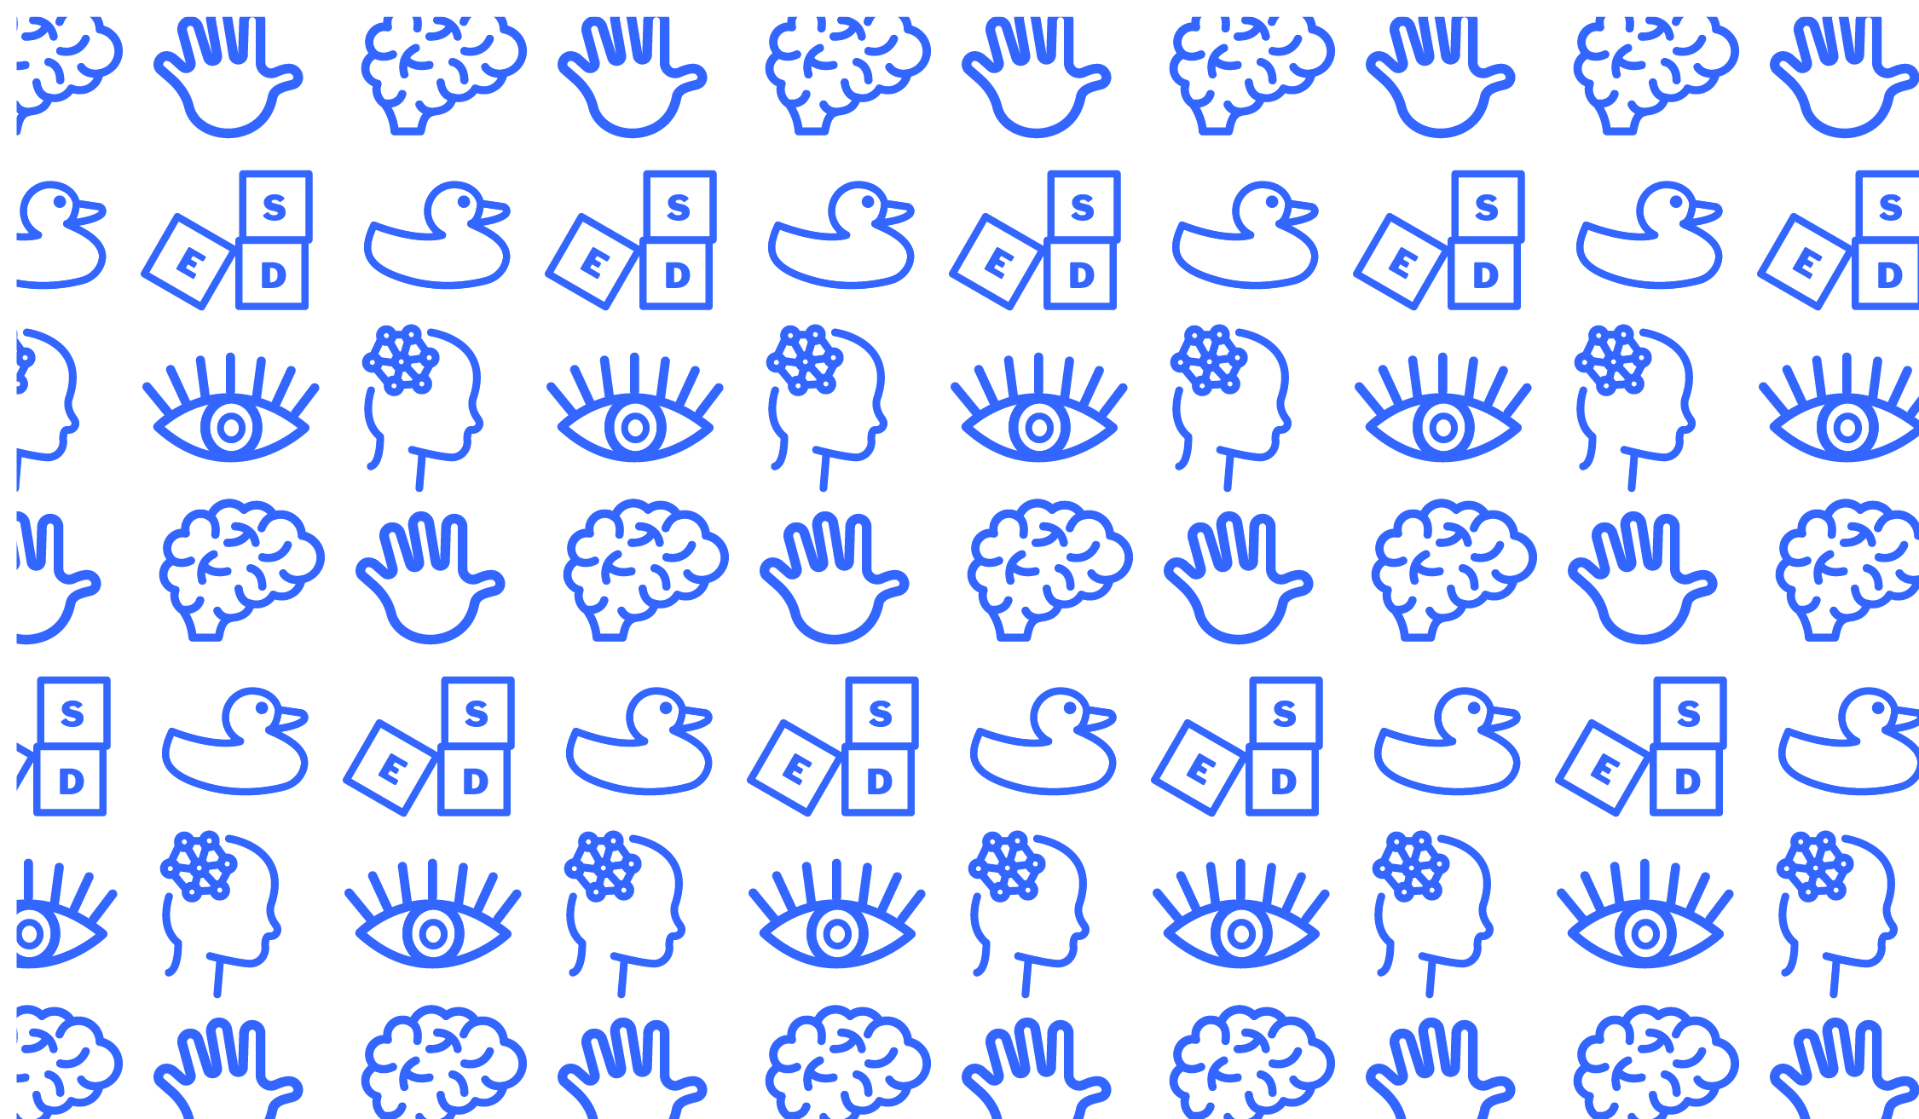
Discussion
Files
caregiver_cluster_analysis.ipynb
Caregiver Outputs: 13 tables, 6 figures, output_manifest.csv
Early Social Development Lab
University of South Carolina
Four things I need before this goes further:
The REDCap data dictionary and slider anchors
The Values scoring and centering formula
The verified key for tfa_behavior_age
A written rule for how the 135-ID cohort was selected
Notes:
I will stop there and open it up. The short summary I would give if someone asks for one sentence is that caregiver acceptability sits on a gradient rather than in types, that where a caregiver sits on that gradient tracks strongly with whether they say they would screen, and that it does not track with who they are demographically or with how much they know about autism. The four items on the left are what I need to move this from exploratory to something we could act on, and the cohort rule is the one I would chase first because it affects every number in the deck.

